Slide 1
Syne User Management -Database Coding Standards
By Author

Slide 2
Agenda
Syne User Management Database – Naming Standards
Syne User Management Tables - Standards
Syne User Management Stored Procedures – Standards
Syne User Management Central DB – Detail
Syne User Management Stored Procedures Sample
Syne User Management Database Deployment Flow

Slide 3
Syne User Management Database – Naming Standards
# Database names should be in Pascal case, first letter of each word capitalized (i.e., EastClaim).
# Database names should NOT contain an environment determined portion – the database should be named the same in Development, Test and Production.
# Databases should otherwise follow general object naming conventions.

Slide 4
Syne User Management Tables - Standards
Points to be considered during naming table
Are descriptive and not cryptic.
Are in Pascal case naming convention with the first letter of each word capitalized.
Contain underscores only to separate major groups of tables or something that may be client or application specific;
Should denote relationship entities using the names of the tables related separated by an underscore. For instance, Client_MenuItem clearly relates tables Client and MenuItem, whereas ClientMenuItem is less obvious;
Do not contain “table” or “tbl” or some other variant as a prefix or suffix
Are placed in the ADMIN and UTILITY schemas if they are administrative or utility tables
Otherwise follow the object naming rules above.

Slide 5
Syne User Management Tables - Standards
If a table is expected to have a limited life expectancy it should be named ‘TempTabledescriptionyyyymmdd’ where yyyymmdd is the date the table can be dropped - for example TempCustomer20060701. This allows DBA and automated operation to delete these objects upon expiration. The date used is the date AFTER which a table may safely be dropped, not the date it was created.

Slide 6
Syne User Management Stored Procedures - Standards
Do not use Dynamic SQL without approval. Dynamic SQL by definition will have to be recompiled every execution, and thus can carry a performance penalty. Dynamic SQL also opens up the possibility of SQL Insertion, which can cause security weaknesses.
Do not use cursors without approval. Cursors in SQL Server carry a substantial performance penalty. Most work can be done using set operations, and work that cannot often contains business logic that does not belong in the database in an N-tiered architecture. Note that this may not apply for a one time execution, such as in a deployment. If cursors are necessary make sure they are Closed then Deallocate.
Do not use SELECT..INTO without approval. SELECT…INTO creates additional overhead on the server as compared to INSERT INTO. Explicitly create then populate tables separately.

Slide 7
Syne User Management Stored Procedures - Standards
Use of temporary tables can cause stored procedure recompiles. In SQL Server 2005 and later table variables can be used with small datasets but can be less efficient for larger data sets where indexes can be helpful.
Use SET NOCOUNT ON at or near the top of your stored procedures.

Slide 8
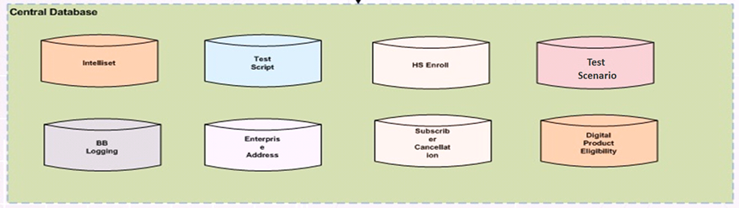
Syne User Management Central DB - Detail

Slide 9
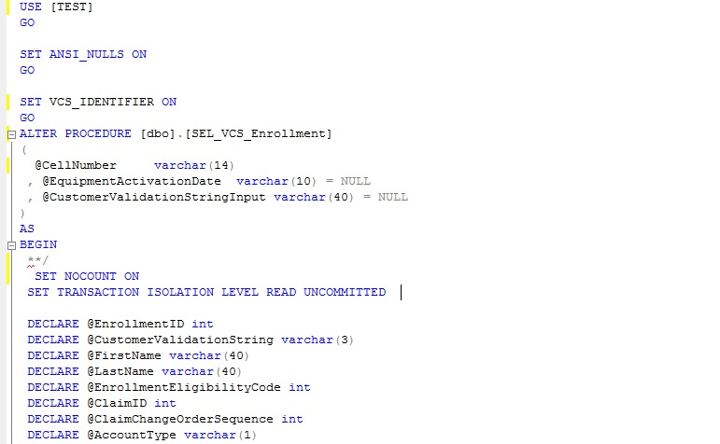
Syne User Management Stored Procedures Sample

Slide 10
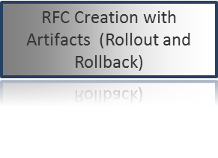
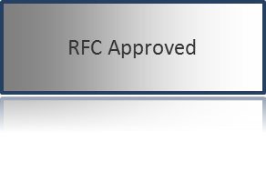
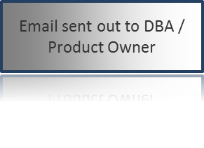
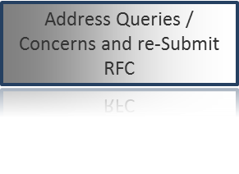
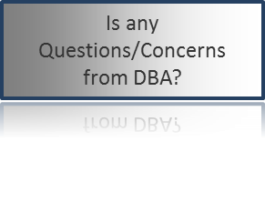
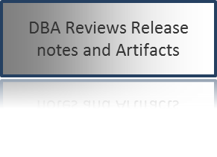
Syne User Management Database Deployment Flow
Start
No
Yes
End

Slide 11
Thank You !

